Slide 1
Anaconda

Slide 2
What is Anaconda ?
Anaconda is a package manager, an environment manager, a Python/R data science distribution, and a collection of over 7,500+ open-source packages.
Anaconda is free and easy to install, and it offers free community support.
Anaconda also has a separate enterprise edition that has complete enterprise support
Anaconda has support for the following
Anaconda Navigator ( GUI based Tool)
Anaconda command line support
You can also make your own custom packages using the conda build command, and you can share them with others by uploading them to Anaconda.org, PyPI, or other repositories.

Slide 3
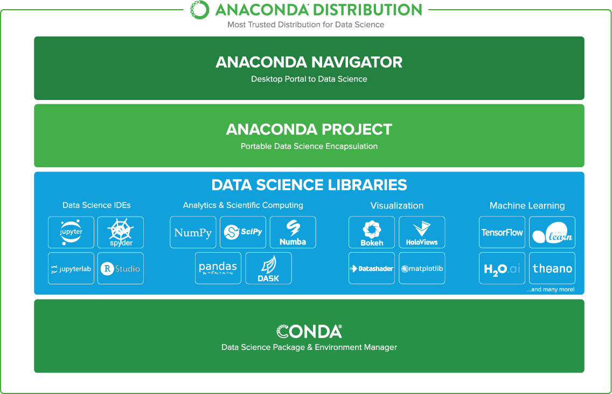
Anaconda Architecture

Slide 4
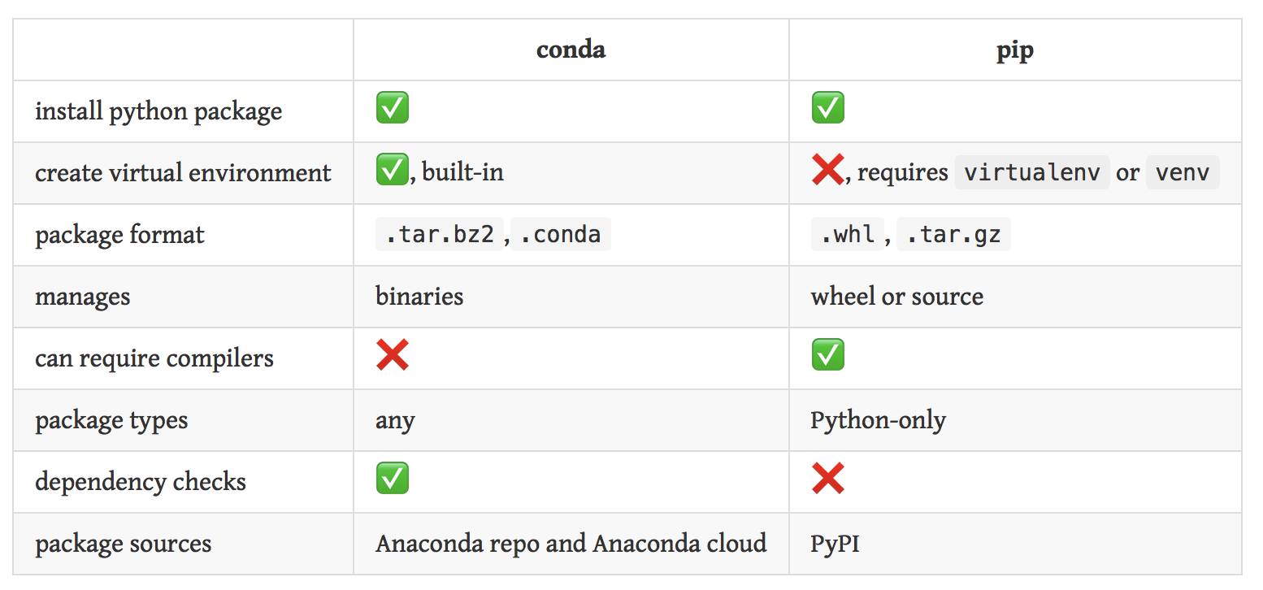
Anaconda Vs Pip

Slide 5
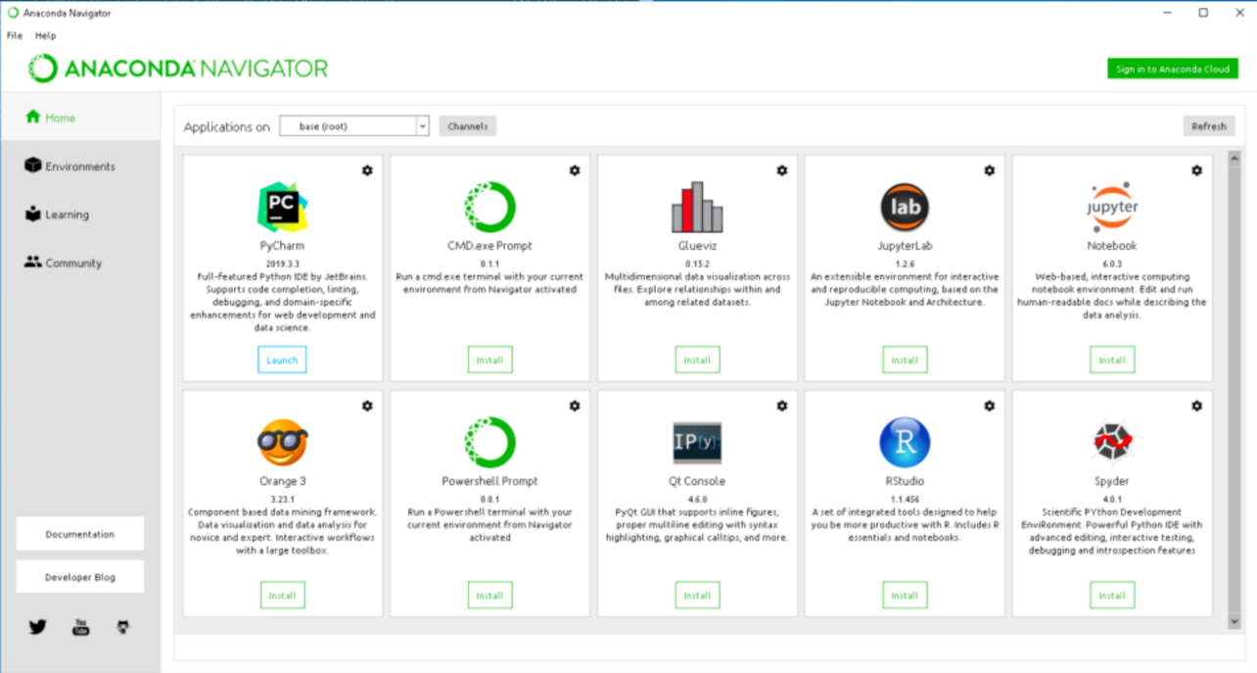
The Navigator
Data scientists often use multiple versions of many packages and use multiple environments to separate these different versions.
The command-line program conda is both a package manager and an environment manager.
This helps data scientists ensure that each version of each package has all the dependencies it requires and works correctly.
Navigator is an easy, point-and-click way to work with packages and environments without needing to type conda commands in a terminal window. You can use it to find the packages you want, install them in an environment, run the packages, and update them – all inside Navigator.

Slide 6
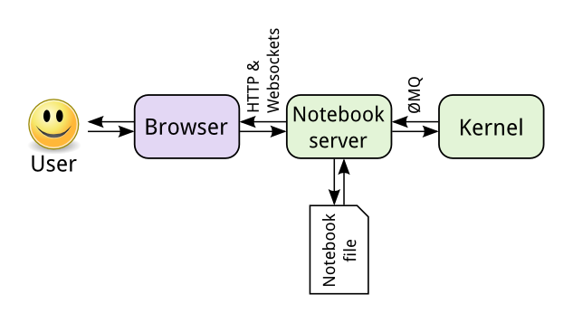
Jupyter Notebook
The Jupyter team maintains the IPython kernel since the Jupyter notebook server depends on the IPython kernel functionality.
Kernels are programming language specific processes that run independently and interact with the Jupyter Applications and their user interfaces. IPython is the reference Jupyter kernel, providing a powerful environment for interactive computing in Python.
Jupyter Notebook and its flexible interface extends the notebook beyond code to visualization, multimedia, collaboration, and more. In addition to running your code, it stores code and output, together with markdown notes, in an editable document called a notebook.

Slide 7
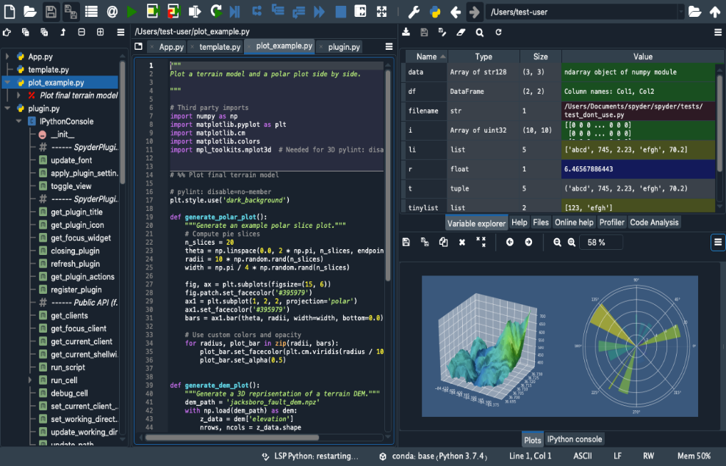
Spyder
Spyder is included by default in the Anaconda Python distribution, which comes with everything you need to get started in an all-in-one package
Spyder can be maintained/installed/updated in dedicated environments using conda support
Features of Spyder
Customizable Syntax Highlighting
Availability of breakpoints (debugging and conditional breakpoints)
Interactive execution which allows you to run line, file, cell, etc.
Run configurations for working directory selections, command-line options, current/ dedicated/ external console, etc
Can clear variables automatically ( or enter debugging )

Slide 8
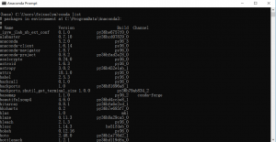
Anaconda Prompt
A program in which commands are entered as text, one line at a time, for a computer to execute. This is done in the Anaconda Prompt in Windows, and in a terminal in macOS and Linux.
Anaconda command prompt is just like command prompt, but it makes sure that you are able to use anaconda and conda commands from the prompt, without having to change directories or your path.
During the installation of Anaconda there is a choice to add these to the PATH by default, and if checked you can also use these commands on the regular command prompt. But the anaconda prompt will always work.

Slide 9
Anaconda Prompt
Create a new environment
conda create -n py3 python=3.7 pandas
# Clone an exist environment.
conda create --name new_env --clone old_env
Enter the environment by name.
# Linux, Mac
source activate env_name # source deactivate
# Windows
activate env_name # deactivate
List all conda environment.
conda env list
Installation of a Package
conda install package_name

